Slide 1
Architecture,
API’s,
and Client Applications
Patterns

Slide 2
TODO
Conceptually a client can be a server, and a server can also be a client. It’s a matter of perspective. I tend to think of it as a big graph.
Review what they learned from the project:
* Client Library for networked applications: Have it ship with the application
* Basic Networking and protocols - Just string processing
Create User interface with Tkinter or OpenGL or Raylib whatever you want.
Issue: Downloading
Implement sending client application over network
Application to download
WOW! Application dev!
Websites as applications we send over the network. Lighter weight, temporary downloads

Slide 3
Codified
Command Module (Client-Side):
User Interface: Allows the user to type messages.
Command Creator: Formats the user's input as a command. For example, if the user wants to send a message, they type "send Hello World!" and the command module packages this as {command: "send", message: "Hello World!"}.
Command Sender: Sends the packaged command to the server via the network.
Parse Module (Server-Side):
Command Receiver: Listens for incoming commands.
Command Parser: Analyzes the received command. If the command is {command: "send", message: "Hello World!"}, it identifies "send" as the command type and "Hello World!" as the message.
Command Executor: Takes the parsed command and performs the corresponding action, such as broadcasting the message to all connected clients.

Slide 4
Objective
Review
Basic Network Architecture
API’s
Client Applications

Slide 5
Network Architecture

Slide 6
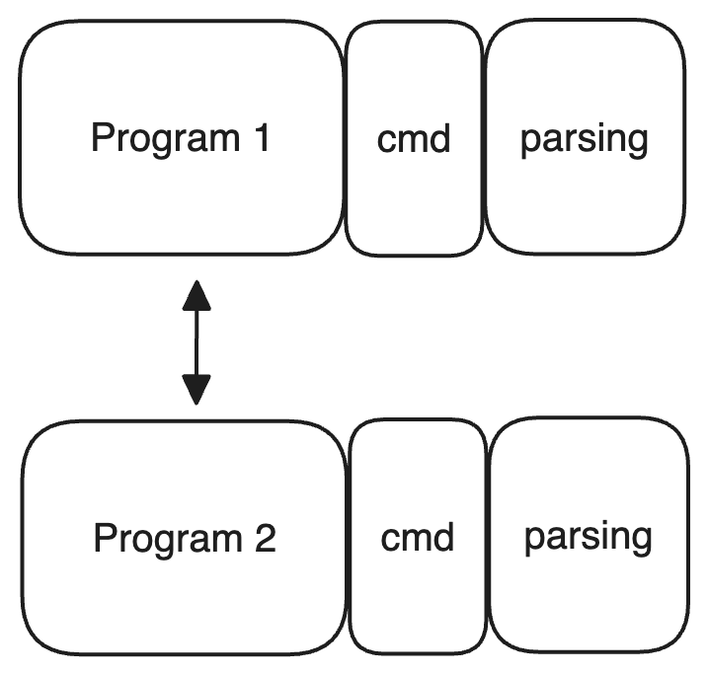
Basic Architecture So Far
Example of Program with Bidirectional Communication
Multiple programs on multiple computers interacting via shared protocol
Notes:
Bidirectional Communication = Commands sent both ways
Command Module: Generating and sending commands to remote
Parsing Module: Receiving and interpreting commands
Not official terms

Slide 7
Example
Code

Slide 8
Basic Architecture
Previously a graph
Abstractions:
Client Server: Commands sent from Client - Server Handles
Peer to Peer: A graph
A client can be a server for another application, and vice versa
Notes:
Draw this out
I generally like just thinking of everything as a graph since it feels less limiting.

Slide 9
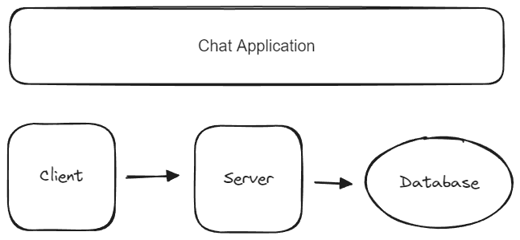
Starter Client Server Architecture
Note: You can make this as crazy as you want or as basic
Notes:
NOTE: YOU DON'T NEED A DATABASE
You can have multiple databases, or none
You can call interfaces from anywhere

Slide 10
Design
File Sharing System
Requirements - Functional and Non functions
Design Server Interface (Exposed Functions)
Basic Architecture
Data Model
Notes:
DESIGN Client Server and Think about Peer to Peer

Slide 11
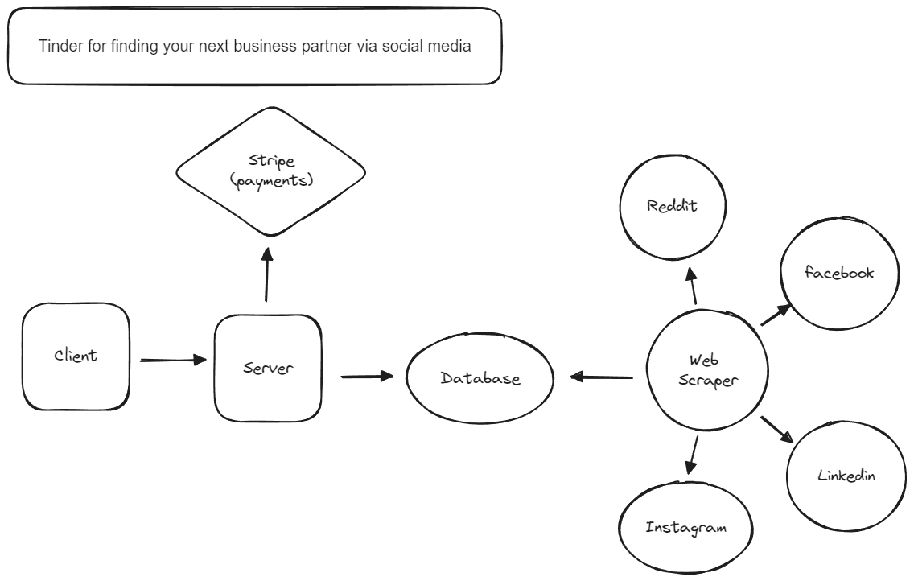
Example Program
Notes:
We will talk about stripe next

Slide 12
API’s

Slide 13
APIs: Using others network programs as Services
All network resources can technically be used by you.
Some will provide messy data (eg. HTML, CSS, JS)
Some will provide clean data (eg. JSON, CSV, Images)
Some are full on services which make your life easier!
Notes:
Kinda a silly term IMO
Note: You will probably need to do some sort of authentication

Slide 14
Network Applications as Services
https://docs.stripe.com/api : Online Payments
https://auth0.com/ : User Authentication
https://www.twilio.com/ : Text Message Services
If not sure, google <product> API

Slide 15
Design
MVP of Application which emails a random potato image to everyone who comments on your instagram post their email address
Design a full Business Application for the above as a Service
Notes:
https://developers.facebook.com/docs/instagram-api/getting-started
https://developers.facebook.com/docs/instagram-api/guides/comment-moderation

Slide 16
Client Applications

Slide 17
Client Applications
If user facing, will have a user interface:
CLI: apt
TUI: aptitude
GUI: synaptic

Slide 18
GUI’s From Scratch
Very tedious - ioctl system calls, device protocols and vector math
https://stackoverflow.com/questions/67756551/linuxs-system-calls-for-gui
Notes:
The ioctl system call is how we interact with devices connected to your computer.
Imagine how every computer has devices that connect to it - you can think of this as another distributed system. Which means what?
There has to be a protocol.
We are’t going to do this, because that’s tedious

Slide 19
Libraries for GUI’s
Find something in your language around the abstraction level you want
Java: Swing, JavaFX, SwingX
Python: Tkinter, PyGUI, Kivy
C: OpenGL, sdl2, Raylib

Slide 20
Basic Multiplayer Game
Goal: Create the outline of a multiplayer game where people can join and move around
Should have a non authoritative server
Source Code
Notes:
TALK ABOUT WHAT AUTHORITATIVE IS
Authoritative means it holds all the game state - This means we can do sanity checks. Like did X shoot through a wall.
HOW:
Need shared state
Networked Database? Slow for real time applications
File database? Might work
All processes share memory? (Threads) - Requires non blocking IO

Slide 21
Steps
Get a bidirectional connection working
Implement user joining
New Player connects to the server
Server creates a data structure for the player
Server broadcasts to all users a new user has joined and their state
Implement player movement
Client Movement of character sends updated x/y location to server
Server broadcasts updated location
Clients receive broadcast and updates users locations on GUI

Slide 22
Whats Next
Disconnecting
Actual game features
Optimizations
Sanity checks to prevent cheating and make server authoritative

Slide 23
Resources
For when making real time games gets that deep:
https://www.gabrielgambetta.com/entity-interpolation.html
https://www.boristhebrave.com/2019/07/28/dungeon-generation-in-enter-the-gungeon/

